Slide 1


Grade 12 Technical Sciences
Term 2:
Matter and materials

Slide 2


Organic chemistry
2.1 Organic compounds
An organic molecule is a compound that contains carbon atoms.
Quick facts
The following carbon compounds are exceptions and are regarded as inorganic compounds:
• carbon monoxide (CO);
• carbonates (CO₃²⁻);
•carbon dioxide (CO₂);
•cyanides (CN⁻).

Slide 3
Organic chemistry
Carbon is the basic building block of organic compounds that is recycled through the earth’s air, water, soil and living organisms.
Carbon’s electron distribution:
1. Carbon is found in group IV of the Periodic Table and has four valence electrons.

Slide 4
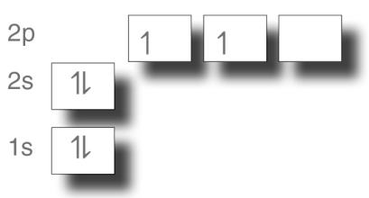
Organic chemistry

Slide 5
Organic chemistry
Carbon forms a maximum of four covalent
bonds with other carbon atoms.
2.2 Homologous series
A homologous series is a series of compounds that are described by the same general formula. Each member in the series differs from the following one by –CH₂.

Slide 6
Organic chemistry
The homologous series that we will study
are:
• alkanes;
• alkenes;
• alkynes;
• alkyl halides;
• alcohols;
• aldehydes;
• ketones;
• carboxylic acids;
• esters.

Slide 7
Organic chemistry
2.3 Functional group
A functional group is a bond, an atom or a group of atoms that determines the chemical properties of the compound.

Slide 8
Organic chemistry
Functional groups of organic compounds are:
Homologous series
Alkanes
Structure or functional group
only
and
single bonds

Slide 9
Organic chemistry
Example of compound
Name
Ethane
Structural formula

Slide 10
Organic chemistry
Homologous series
Alkenes
Structure or functional group

Slide 11
Organic chemistry
Example of compound
Name
Ethyne
Structural formula

Slide 12
Organic chemistry
Homologous series
Alkyne
Structure or functional group
Example of compound
Name
Ethyne
Structural formula

Slide 13
Organic chemistry
Homologous series
Alkyl halides
(haloalkanes)
Structure or functional group
(X = F, Cℓ, Br, I)

Slide 14
Organic chemistry
Example of compound
Name
Bromoethane
Structural formula

Slide 15
Organic chemistry
Homologous series
Alcohols
Structure or functional group

Slide 16
Organic chemistry
Example of compound
Name
Ethanol
Structural formula

Slide 17
Organic chemistry
Homologous series
Aldehydes
Structure or functional group

Slide 18
Organic chemistry
Example of compound
Name
Ethanal
Structural formula

Slide 19
Organic chemistry
Homologous series
Ketones
Structure or functional group

Slide 20
Organic chemistry
Example of compound
Name
Propanoon
Structural formula

Slide 21
Organic chemistry
Homologous series
Carboxylic acids
Structure or functional group

Slide 22
Organic chemistry
Example of compound
Name
Ethanoic acid
Structural formula

Slide 23
Organic chemistry
Homologous series
Esters
Structure or functional group

Slide 24
Organic chemistry
Example of compound
Name
Methyl ethanoate
Structural formula

Slide 25
Organic chemistry
2.4 Molecular and structural formulae
Type of formula Molecular formula
Description A chemical formula that gives an indication of the type and number of atoms in a molecule.
Example
Name
Propane
Formula
C₃H₈

Slide 26
Organic chemistry
Type of formula
Condensed formula
Description
It is the shortened form of the structural formula. It indicates the atoms in the compound, but not all the bonds.
Example
Name
Propane
Formula
CH₃CH₂CH₃

Slide 27
Organic chemistry
Type of formula
Structural formula
Description It indicates all the atoms in the molecule individually. Atoms are represented by their chemical symbols. Lines indicate all bonds. It is only two-dimensional and does not represent the geometric shape.
Example
Name
Propane
Formula

Slide 28
Organic chemistry
Examples of molecular, structural and condensed formulae:
Molecular formula
C₄H₁₀
Structural formula
Condensed formula
CH₃CH₂CH₂CH₃ of CH₃ (CH₂)₂CH₃
NOTE: Groups that are repeated may be written in brackets with the amount of times they are repeated after them.

Slide 29
Organic chemistry
Molecular formula
C₅H₁₂
Structural formula
Condensed formula
CH₃CH(CH₃)CH₂CH₃ of
NOTE: Branches are written in brackets after the carbon to which they are bonded.

Slide 30
Organic chemistry
Molecular formula
C₆H₁₄
Structural formula
Condensed formula
or
CH₃CH₂CH(CH₃)CH₂CH₃
NOTE: Brackets indicate that CH3 is a branch and is bonded to the previous C.

Slide 31
Organic chemistry
Molecular formula
C₄H₈
Structural formula
Condensed formula
CH₃CH=CHCH₃
NOTE: Keep the double bond.

Slide 32
Organic chemistry
Molecular formula Structural formula
C₅H₁₁OH
OR
C₅H₁₂O
Condensed formula
CH₃CH₂CH(CH₃)CH₂OH or
NOTE: The sequence of the OH is important. The O is between the C and the H so that there can be a single bond with the O, which is in turn bonded to the H.

Slide 33
Organic chemistry
Molecular formula Structural formula
CH₃CHO
OR
C₂H₄O
Condensed formula
CH₃CHO or
NOTE: The sequence of the HO is important. The H is between the C and the O so that there can be a double bond with the O.

Slide 34
Organic chemistry
Molecular formula Structural formula
CH₃COOH
OR
C₂H₄O₂
Condensed formula
CH₃CO₂H or CH₃COOH or

Slide 35
Organic chemistry
Molecular formula Structural formula
C₃H₆O₂
Condensed formula
CH₃CO₂CH₃ or CH₃COOCH₃ or

Slide 36
Organic chemistry
Molecular formula
C₅H₁₀O
Structural formula
Condensed formula
CH₃CH₂COCH₂CH₃ or

Slide 37
Organic chemistry
2.5 Saturated hydrocarbons
Saturated hydrocarbons are hydrocarbons that contain only single covalent bonds between the carbon atoms.
2.6 Unsaturated hydrocarbons
Unsaturated hydrocarbons are hydrocarbons that contain one or more covalent double or triple bond between the carbon atoms.

Slide 38
Organic chemistry
2.7 Isomers
Compounds with the same molecular formula, but different structural formulae, are known as structural isomers.
Isomers can be the following:
• chain isomers: different chains; • positional isomers: different positions of the same functional group; • functional isomers: different functional groups.

Slide 39
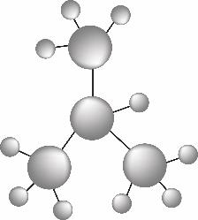
Organic chemistry
Example: two chain isomers of C₄H₁₀
Methyl propane

Slide 40
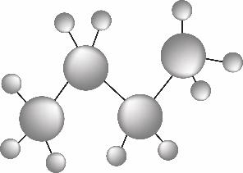
Organic chemistry
Butane

Slide 41
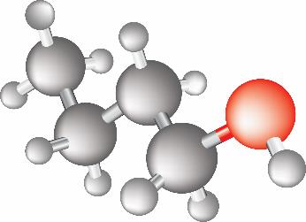
Organic chemistry
Example: two positional isomers of
C₄H₉OH
Butan-1-ol

Slide 42
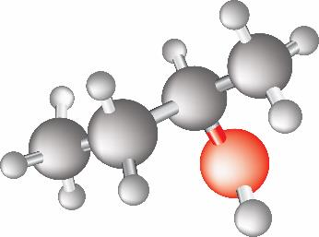
Organic chemistry
Butan-2-ol

Slide 43
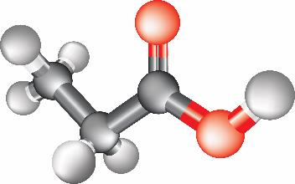
Organic chemistry
Example: two functional isomers of
C₃H₆O₂
Propanoic acid

Slide 44
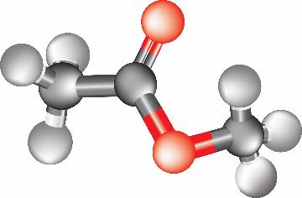
Organic chemistry
Methyl ethanoate

