Slide 1
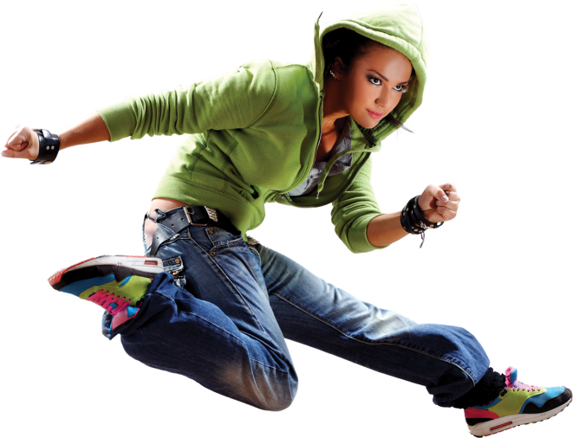

Grade 12 Physics
Knowledge area:
Mechanics

Slide 2
Work, energy and power
3.1.3 Potential energy (E_{P})
The energy of an object due to its position in a field. In this case: a gravitational field

Slide 3

Work, energy and power
only the magnitude(N)
potential energy (J)
mass (kg)
E_{P} = weight × height = mgh
vertical perpendicular height (m)
gravitational acceleration (m⋅s⁻²)
vertical height (m)

Slide 4
Work, energy and power
Examples
A crane lifts a car, mass 1 000 kg, at a constant speed, to a height of 5 m. What is the potential energy of the car at that height? (Or we can ask: how much work is done on the car by the crane? The solution is the same as for work done by gravitational force.)
E_{P} = mgh
= 1 000 × 9,8 × 5
= 49 000 J

Slide 5
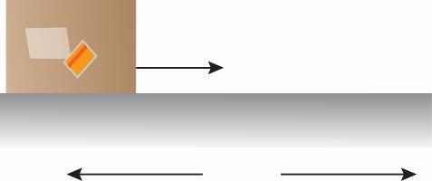
Work, energy and power
3.1.4 Kinetic energy (E_{K})
This is the energy of an object due to its motion.
A horizontal force F pulls an object, mass m, across a smooth horizontal surface.
v_{i} = 0
F
v
Δx

Slide 6
Work, energy and power
Force F does work over the distance Δx of:
W = F_{applied}⋅Δx (cosθ)
but:
v_{f}² = v_{i}² + 2aΔx
W = F_{applied}⋅Δx (cos0°) 1
and because:
v_{i} = 0 is and v_{f} = v is
aΔx = ½v² 2

Slide 7
Work, energy and power
The only force applied in the direction of motion is the applied force F, therefore the resultant force is also the applied force.
F_{net} = ma = F_{applied}
Thus W = maΔx cos0° from 1
and W = m(aΔx) = m(½v²) from 2
W = ½mv²
and this is equal to the kinetic energy gained by the object, because work was done on it.

Slide 8
Work, energy and power
kinetic energy (J)
Kinetic energy= E_{K} = ½mv²
velocity (m⋅s⁻¹)
mass (kg)

Slide 9
Work, energy and power
Initial velocity not zero:
Change in the kinetic energy
= ΔE_{K}
= ½m(v_{f}² - v_{i}²)
= ½mv_{f}² - ½mv_{i}²
initial velocity
(m⋅s⁻¹)
final velocity (m⋅s⁻¹)

Slide 10
Work, energy and power
Examples
A trolley, mass 2 kg, is moving at 10 m⋅s⁻¹.
A force of 100 N is applied to the trolley, in the direction of motion, over a distance of
5 m. What is the velocity of the trolley now?
Final velocity v_{f} must be calculated.

Slide 11
Work, energy and power
The work done on the trolley results in an increase in kinetic energy.
FΔx cosθ = ½mv_{f}² - ½mv_{i}²
(Work is done by the resultant force.)
100 × 5 cos0° = ½(2)v_{f}² - ½(2)(10)²
500 = v_{f}² - 100
v_{f}² = 600
v_{f} = √600
= 24,5 m⋅s⁻¹

Slide 12
Work, energy and power
3.1.5 Mechanical energy
Mechanical energy is the sum of an object’s gravitational potential energy and kinetic energy at a specific position (E_{M} = E_{P} + E_{K}).
A E_{P} = mgh = 1 × 9,8 × 10 = 98 J
E_{K} = 0 (falls from rest) Mechanical energy = 98 + 0 = 98 J
B E_{P} = 1 × 9,8 × 5 = 49 J
E_{K} = ½mv² where v²
= 0 + 2(9,8)(5) = 98
∴ E_{K} = ½(1)(98)
= 49 J
Mechanical energy = 49 + 49 = 98 J

Slide 13
Work, energy and power
C E_{P} = 1 × 9,8 × 2 = 19,6 J
E_{K} = ½mv² = ½(1)(2 × 9,8 × 8)
= 78,4 J
Mechanical energy = 19,6 + 78,4 = 98 J
D E_{P} = 0
E_{K} = ½(1)(2 × 9,8 × 10) = 98
Mechanical energy = 0 + 98 = 98 J
Law of conservation of mechanical energy: If there are no external forces such as friction or resistance, the total mechanical energy of the system is conserved.

Slide 14
Work, energy and power
3.1.6 The work-energy principle
The work done on an object by the resultant/net force is equal to the change in kinetic energy of the object.
⋅Δx cosθ
Symbol form: W_{net} = ΔE_{K}
= E_{Kf} - E_{Ki}
change in kinetic energy (J)
final velocity (m⋅s⁻¹)
verplasing (m)
initial velocity (m⋅s⁻¹)
W_{net} = ΔE_{K}
F_{net}⋅Δx cosθ = ½mv_{f}² - ½mv_{i}²
net force(N)
mass
(kg)

Slide 15
Work, energy and power
Examples
Leon pushes a crate, mass 50 kg, with a force, 200 N, across a rough horizontal surface as indicated in the diagram. The crate is initially at rest. The friction between the crate and the surface is 120 N.

Slide 16
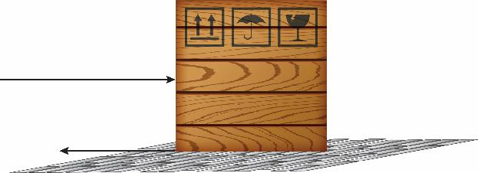
Work, energy and power
Calculate the velocity of the crate after Leon has pushed it a distance of 8 m in a straight horizontal line.
Choose to the right as positive.
50 kg
200 N
120 N

Slide 17
Work, energy and power
The net force on the crate is
+200 - 120 = 80 N to the right.
The work done on the crate by the net force = ΔE_{K} of the crate
F_{net}Δx cosθ = ½mv_{f}² - ½mv_{i}²
(80)(8)cos0° = ½(50)v_{f}² - ½(50)(0) ²
(net force and displacement in same direction)
v_{f} = 5,06 m⋅s⁻¹ to the right

Slide 18
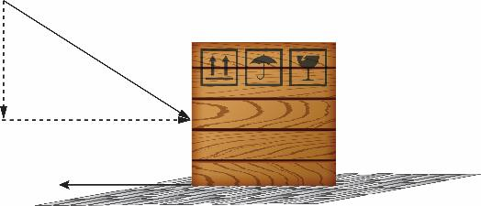
Work, energy and power
The net force isF_{x} - f = 200 cos30° - 145
= 28,2 N
F_{net}Δx cosθ = ½mv_{f}² - ½mv_{i}² (28,2)(8)cos0 ° = ½(50)v_{f}² - ½(50)(0)²
v_{f} = 3 m⋅s⁻¹ to the right
200 N
50 kg
30°
200 cos30°
140 N

Slide 19
Work, energy and power
It can also be written directly as: F_{net}Δx cosθ = ½mv_{f}² - ½mv_{i}²
(200 cos30° - 145)(8) = ½(50)v_{f}² - ½(50)(0)²

Slide 20
Work, energy and power
Examples
A trolley, carrying a sandbag, moves down a frictionless incline. When it reaches the bottom, point B, it moves to point C at a constant velocity of 2 m⋅s⁻¹ in the direction as indicated on the diagram. The sandbag and the trolley have a combined mass of
4 kg. A bullet with mass 0,15 kg, is fired, as indicated, and is stuck in the sandbag

Slide 21
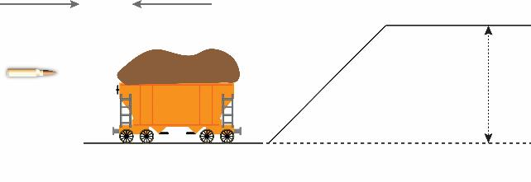
Work, energy and power
State the principle in words that will be used to solve this problem.
Calculate the magnitude of the velocity of the bullet before the collision.
2 m⋅s⁻¹
A
v
0,15 kg
h
4 kg
C
B

Slide 22
Work, energy and power
Calculate the kinetic energy of the trolley with the sandbag and bullet after the collision
Calculate the kinetic energy of the trolley with the sandbag and bullet after the collision
1. The total linear momentum of a closed system is conserved in magnitude and direction.

Slide 23
Work, energy and power
2. Total momentum before collision = total momentum after collision (Choose to the right as +.)
∑p_{before} = ∑p_{after}
m₁v_{1i} + m₂v_{2i} = (m₁ + m₂)v_{f} (0,15)(v₁i) + 4(-2) = (4 + 0,15)(5,3)
v_{1i} = 199,97 m⋅s⁻¹
to the right
3. E_{K} = ½mv²
= ½(4,15)(5,3)²
= 58,29 J

Slide 24
Work, energy and power
4. For the trolley to be able to reach point A, its velocity at A must be 0 m⋅s⁻¹.
The velocity of the trolley and bullet at B is 5,3 m⋅s⁻¹.
There is no friction (closed system).
Use the law of conservation of mechanical energy.

Slide 25
Work, energy and power
E_{M} at B = E_{M} at A
(E_{P} + E_{K})_{B}= (E_{P} + E_{K}) _{A}
(mgh + ½mv²)_{B} = (mgh + ½mv²) _{A}
(4,15 × 9,8 × 0) + (58,29) = (4,15 × 9,8 × h) + (½ × 4,15 × 0)
h = 1,43 m

Slide 26
Work, energy and power
Examples
Franceska is riding her bicycle on horizontal road. Her speed is 10 m⋅s⁻¹, when she reaches point A.
At point A, she stops pedalling and allows her bicycle to move freely up the slope.
The inclined surface applies a frictional force of 18 N on the tyres of the bicycle.
The combined mass of Franceska and the bicycle is 55 kg.

Slide 27
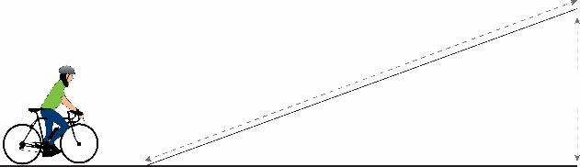
Work, energy and power
Is the mechanical energy of Franceska and her bicycle conserved as they move from A to B?
Explain your answer.
B
8 m
1,2 m
A

Slide 28
Work, energy and power
Calculate the kinetic energy at point A.
Calculate the kinetic energy of the system at the top of the incline.
This problem can be solved in two ways. For the second method, we will use the two components (perpendicular and parallel to the inclined surface) of the weight.

Slide 29
Work, energy and power
No, the mechanical energy is not conserved. There is friction between the tyres and the surface, which means that it is not a closed system.
Kinetic energy = ½mv²
= ½(55)(10) ²
= 2 750 J
3 Draw a force diagram before continuing with this question.

Slide 30
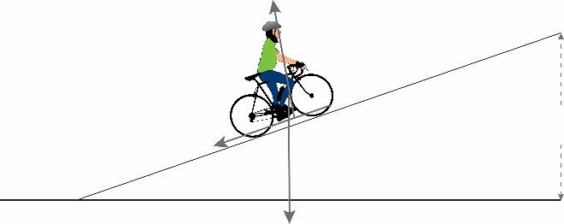

Work, energy and power
normal force
B
1,2 m
friction force 18 N
8,63°
A
weight 539 N
F_{y} = 539 cos8,63°
Weight 539 N
F_{x} = 539 sin8,63°

Slide 31
Work, energy and power
Method 1
Use the following equation because there is
friction:
f_{friction}Δx cosθ* = (E_{KB} - ∆E_{KA}) + (E_{PB} - E_{PA})
(18)(8)cos180° = (E_{K})_{B} – ½(55)(10²)) + ((55)(9,8)(1,2) – 0)
- ½(55)(10²))
-144 = E_{KB} - 2 750 + 646,8
E_{KB} = 1 959,2 J
W_{nc} = ΔE_{K} + ΔE_{P}

Slide 32
Work, energy and power
Method 2
Work done by resultant force= ΔE_{K} of (bicycle + Franceska)
W_{net} = ΔE_{K}
F_{net}Δx cosθ = E_{KB} - E_{KA}
The net force is the vector sum of all the forces acting in a straight line. In this case, both of the forces are opposite to the direction of motion. Observe the force diagram.
(f + f_{gǁ})Δx cosθ = E_{KB} - ½mv²
(18 + 80,88)(8) cos180° = E_{KB} - ½(55)(10)²
-791,03 = E_{KB} - 2 750
E_{KB} = 1 958,97 J

Slide 33
Work, energy and power
3.1.7 Forces
Conservative forces
A force exerted on an object moving in a closed path. The net work done by the force is zero.
Example: gravitational force and resilient forces

Slide 34
Work, energy and power
Non-conservative forces
A force exerted on an object to do the work of moving it from A to B and back to A. It is dependent on the path taken.
Examples: friction and air resistance
No friction/resistance:
(E_{P} + E_{K})_{A} = (E_{P} + E_{K})_{B} (conservation of mechanical energy)

Slide 35
Work, energy and power
With friction/resistance:
W_{net} = ΔE_{K}
W_{nk} = ΔE_{K} + ΔE_{P}
Examples
A brick, mass 2 kg, falls from a height of 45 m above the ground. When it reaches the ground, it falls into a puddle of mud, which brings it to rest in 20 cm. Calculate:

Slide 36
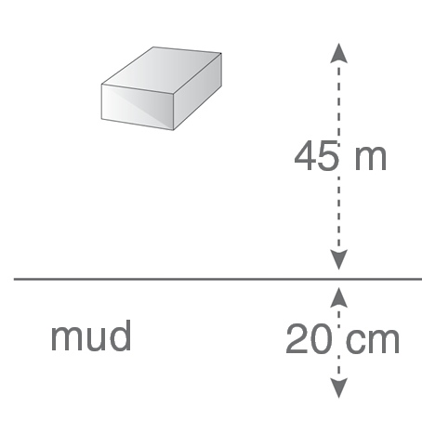
Work, energy and power

Slide 37
Work, energy and power
1. the velocity of the brick as it reaches the ground;
2. the force that the puddle of mud applies on the brick to bring it to rest.
1. Freefall implies that there is no friction or resistance:
(E_{P} + E_{K})_{top} = (E_{P} + E_{K})_{bottom}
(mgh + ½mv²) _{top} = (mgh + ½mv²)_{bottom}
(2 × 9,8 × 45 + 0) = (0 + ½(2)v²)
∴ v = ±29,7 m⋅s⁻¹

Slide 38
Work, energy and power
2. Work by resistance = W_{nc} = ΔE_{K} + ΔE_{P}
FΔy cosθ = (mgh + ½mv²)_{below mud} - (mgh + ½mv²)_{above mud}
F(0,2)cos180° = (0 + 0) - (2 × 9,8 × 0,2 + ½ × 2 × 29,7²)
F = 4 430 N against the brick’s motion
Therefore upwards

Slide 39
Work, energy and power
A system in which resistance or friction is not present, is called a closed/isolated system.
Examples
Andrew is riding a skateboard (combined
mass 60 kg), from rest at point A, to point B,
where he stops, turns around and moves
back towards A. Calculate the work done by
friction between A and B.

Slide 40
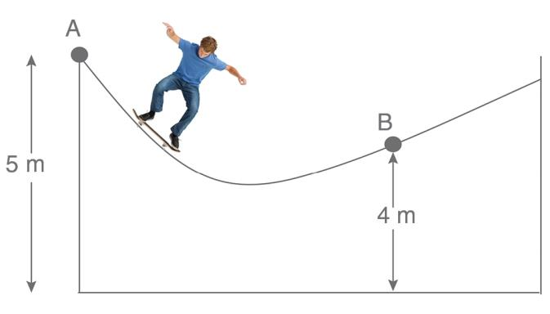
Work, energy and power

Slide 41
Work, energy and power
Take note that there is friction. It is not a closed system.
W_{net} = ΔE_{K}
The velocity is zero at points A and B, which means that the kinetic energy at both points is zero:
W_{net} = 0 J
W_{g} + W_{f} = 0
mgΔx cos0° + W_{f} = 0
60 × 9,8 × 1 = -W_{f}
W_{f} = -588 J

Slide 42
Work, energy and power
Examples
A lead ball, mass 0,5 kg, is fixed to a long, light string and allowed to swing from a vertical height of 1,5 m above the lowest point of the swinging motion.
Calculate the maximum velocity of the ball at the bottom of its swing.

Slide 43
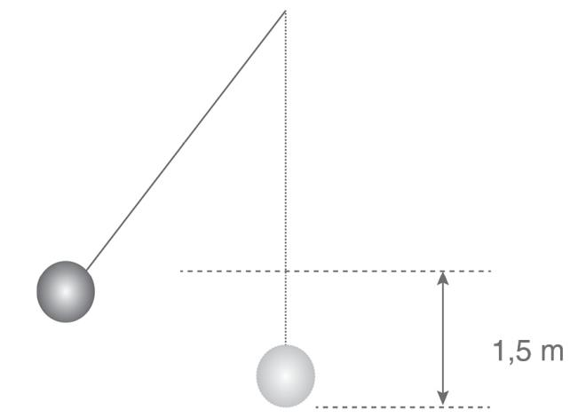
Work, energy and power

Slide 44
Work, energy and power
Unless stated otherwise, we assume that there is no air resistance and that the mass of the string is negligible.
(E_{P} + E_{K})_{top} = (E_{P} + E_{K})_{bottom}
(mgh + ½mv²)_{top} = (mgh + ½mv²)_{bottom}
(0,5 × 9,8 × 1,5 + 0) = (0 + ½ × 0,5 × v²), because the maximum velocity is reached at the lowest point; (zero height).
v = ±5,42 m⋅s⁻¹ The ± means that the velocity can be to the left or the right.

Slide 45
Work, energy and power
Examples
A wooden block, mass 1 kg, hangs from a light string. A bullet, mass 200 g, is fired into the block which causes the block to swing to a height of 0,8 m above its initial height.
Calculate the velocity at which the bullet is fired into the block.

Slide 46
Work, energy and power
Here a collision is combined with pendulum motion.
Height is given for the pendulum motion, and therefore the velocity of the block with bullet can be calculated just after the collision.
The velocity just after the collision can be used to calculate the velocity of the bullet before the collision.

Slide 47
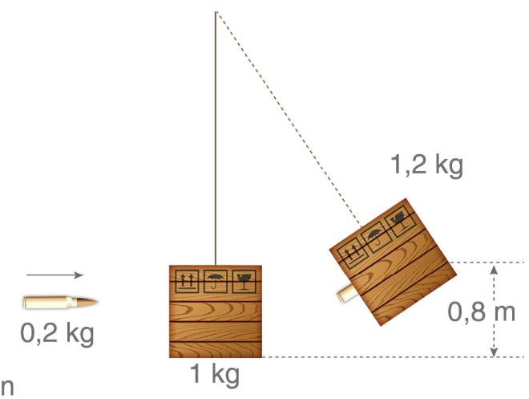
Work, energy and power

Slide 48
Work, energy and power
First we look at the pendulum motion
(E_{P} + E_{K})_{top} = (E_{P} + E_{K})_{bottom}
(mgh + ½mv²)_{top} = (mgh + ½mv²)_{bottom}
(1,2 × 9,8 × 0) + (½(1,2)v²) = (1,2 × 9,8 × 0,8) + (½ × 1,2 × 0²)
Remember that the bullet is in the block during the pendulum motion.
∴ v = ±3,96 m⋅s⁻¹
... and this is the velocity immediately after the collision.

Slide 49
Work, energy and power
And now, for the collision
The block is initially at rest, but after the collision the block and bullet move together at 3,96 m⋅s⁻¹.
Σp_{before} = Σp_{after} p = mv
m₁v_{1i} + m₂v_{2i} = (m₁ + m₂)v_{f}
0,2 × v_{i} + 1,0 × 0 = (1 + 0,2) × 3,96
∴ v_{i} = 23,76 m⋅s⁻¹
This is the velocity of the bullet as it reaches the block.

Slide 50
Work, energy and power
When is the law of conservation of mechanical energy used in problem solving?
There are three types of problems:
pendulum
roller coaster type
Freefall
In the following problem, the principles of momentum and energy are combined.
Remember: closed systems only.

Slide 51
Work, energy and power
Remember:
collisions and similar physical occurrences require the conservation of momentum; and
pendulum motion, without air resistance, requires conservation of mechanical energy.
Examples
Nkosi in his go-kart, combined mass 60 kg, starts from rest at point P and rolls down a slope as indicated in the diagram. Ignore air resistance.

Slide 52
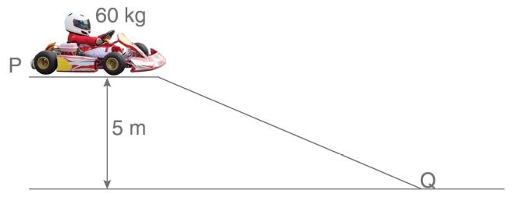
Work, energy and power
Calculate the speed of Nkosi and his go-kart when it reaches Q.
Because there is no friction or air resistance, the law of conservation of mechanical energy is used.

Slide 53
Work, energy and power
(E_{P} + E_{K})_{top} = (E_{P} + E_{K})_{bottom}
(mgh + ½mv²)_{top} = (mgh + ½mv²) _{bottom}
(60 × 9,8 × 5 + 0) = (0 + ½ × 60 × v²)
v = 9,9 m⋅s⁻¹

